Slide 1
Student Name:
Chintala Anu Sree
(Final Project)
Project Title
Key logger & Security

Slide 2
Project overview
Introduction
Types of Key logger
How Key loggers work
Potential threats
Security
Case studies

Slide 3
Introduction
Definition: A key logger is a type of surveillance software that records every keystroke made on a computer or mobile device.
Purpose: Can be used for legitimate purposes (e.g., monitoring employees) or malicious purposes (e.g., stealing passwords and personal information).
A keylogger or keystroke logger/keyboard capturing is a form of malware or hardware that keeps track of and records your keystrokes as you type.

Slide 4
Types of keylogger
Hardware Key Loggers: Physical devices plugged into a computer.
Software Key Loggers: Applications installed on a computer or mobile device
Kernel-based Keyloggers
API-based Keyloggers
Form Grabbing Based Keyloggers

Slide 5
How key loggers work
1. Recording Keystrokes
Capture and log every keystroke made on the keyboard.
2. Storing Data
Save the recorded data locally or remotely, often hidden or encrypted.
3. Transmission Methods
Send the captured data to the attacker via email, FTP, or cloud storage.
4. Advanced Features
Include screen capture, clipboard monitoring, application tracking, and form grabbing.
5. Persistence Mechanisms
Ensure continued operation through startup entries, rootkits, or other methods to avoid detection.

Slide 6
Potential threats
1. Identity Theft
Keyloggers can capture sensitive personal information and account credentials, leading to identity theft and fraud.
2. Corporate Espionage
Capture of proprietary information and trade secrets, which can be used to gain a competitive advantage or disrupt business operations.
3. Financial Loss
Unauthorized transactions and credit card fraud, resulting in significant financial losses. Keyloggers can also be part of ransomware attacks.
4. Privacy Invasion
Monitoring and recording of private communications and online activities, leading to a significant invasion of privacy and potential blackmail.
5. System Damage
Keyloggers are often part of larger malware infections that can damage system files, cause data corruption, and lead to system instability

Slide 7
Security
1. Use Strong Passwords
Create complex passwords and use password managers.
2. Keep Software Updated
Regularly update your OS and applications with security patches.
3. Avoid Suspicious Links
Do not click on unknown links or download attachments from untrusted sources.
4. Use Two-Factor Authentication (2FA)
Implement 2FA for an added layer of security.
5. Secure Network
Use strong Wi-Fi encryption, VPNs, and enable firewall protection.
6. Regular Scans and Monitoring
Use antivirus and anti-malware software for regular system scans and monitoring.
7. Educate and Train Users
Provide training on recognizing phishing and maintaining security best practices.

Slide 8
Modelling
Threat Detection Model
Data Collection
Feature Extraction
Model Selection
Training and Validation
Real-Time Detection
Data Encryption Model
End-to-End Encryption
Key Management
Data Obfuscation

Slide 9
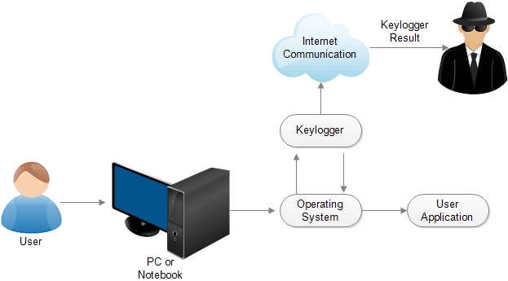
Modelling

Slide 10
Behavioral Model
Use Case Diagram:
Actor: User, System Administrator, Attacker.
Use Cases:
Monitor Keystrokes
Store Captured Data Locally
Transmit Data to Remote Server
Capture Screenshots (optional)
Monitor Clipboard (optional)

Slide 11
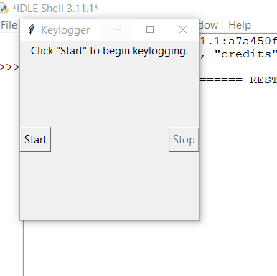
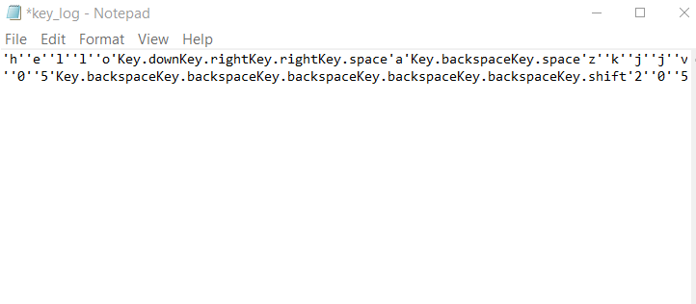
Results

Slide 12
Git repository
Important link(GitHub link):https://github.com/ChintalaAnusree/Cyber-security-final-project-

